Slide 1
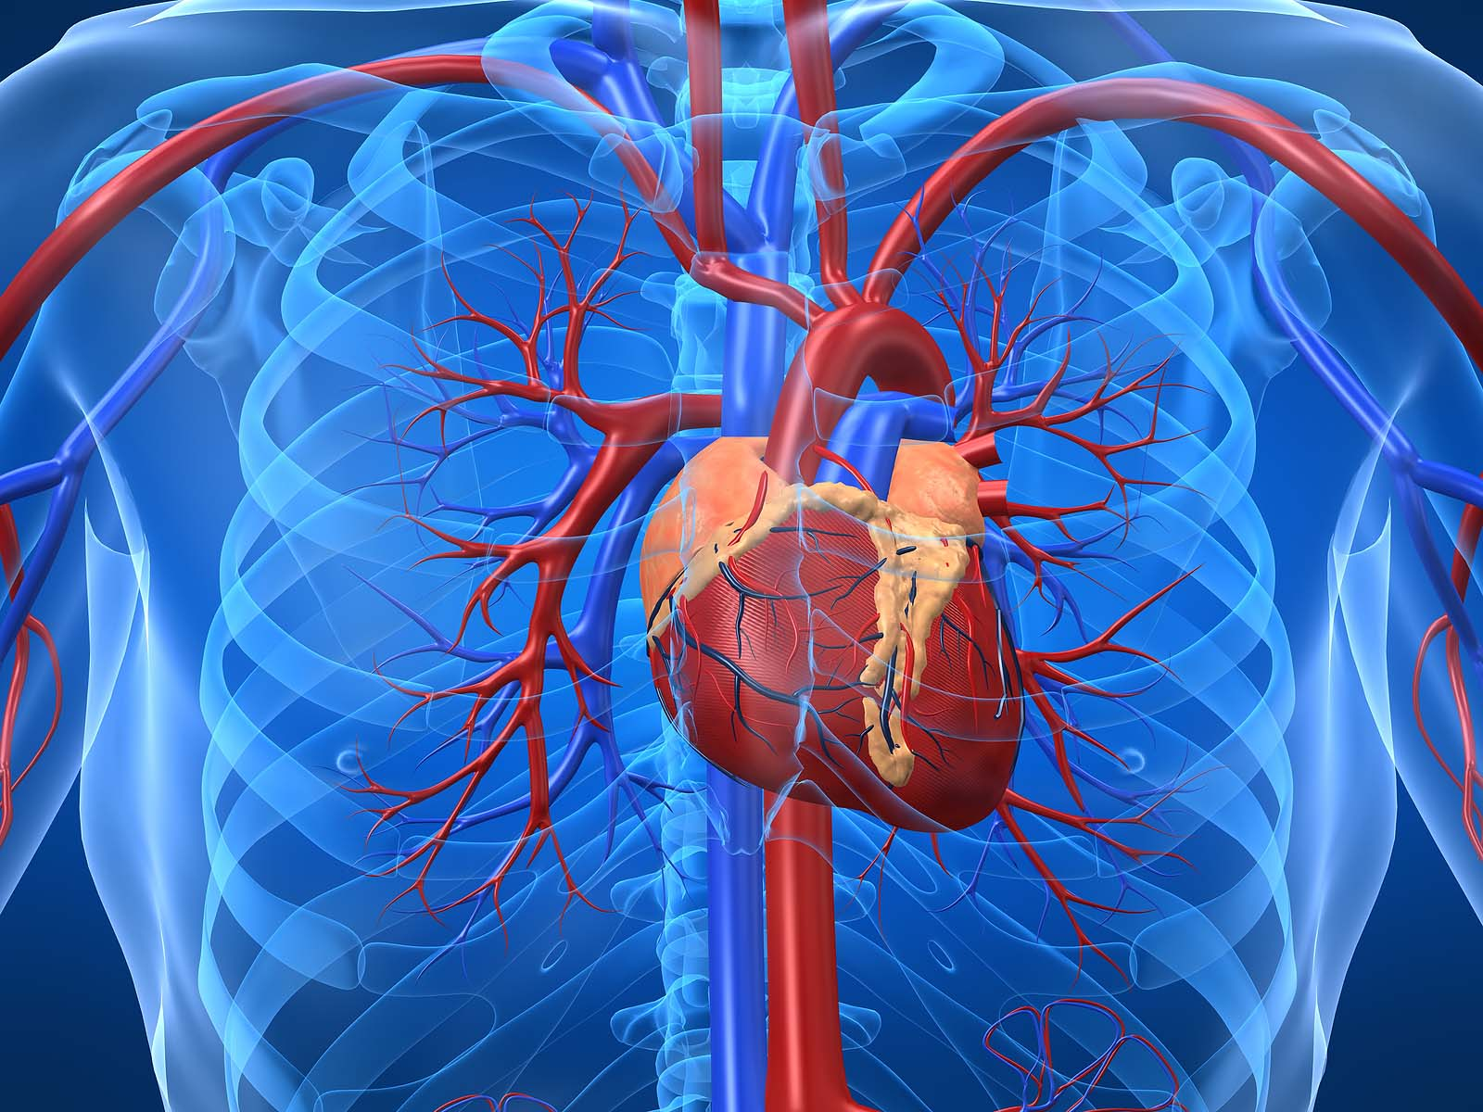
Project Team #1 Coronary Artery Disease (CAD) Predictive Model
By: Danielle Kalkofen, Ph.D., Kaddi Pham,
LaShonda Coleman, and Peggy Blaine
July 12, 2019
https://www.joshgitalis.com/wp-content/uploads/2013/01/Cardiovascular_System.jpg

Slide 2
Coronary Artery Disease Basics
Also known as CAD:
It is a narrowing or blockage of arteries that provide oxygen and nutrients to the heart (see diagram on next slide). ⁽²⁾
It is an important health topic to study, understand, and predict who is likely to develop CAD considering the following facts:
It’s the leading cause of death for both men and women in the United States. ⁽²⁾
More than 13 million Americans have active symptoms of CAD. ⁽²⁾
CAD is preventable. ⁽⁶⁾
Living a healthy lifestyle can delay the progression of CAD. ⁽⁶⁾
CAD begins early in childhood so the earlier the potential for CAD is predicted, the earlier a patient can be trained on healthy lifestyles and adopt measures that can be followed for life; significantly reducing the actual occurrence of CAD which will lead to less deaths caused by CAD. ⁽⁶⁾
CAD is also often incorrectly referred to as coronary heart disease (CHD) and heart disease, though technically, they are not quite the same thing. CHD is actually a result of CAD per the American Heart Association. ⁽⁷⁾

Slide 3
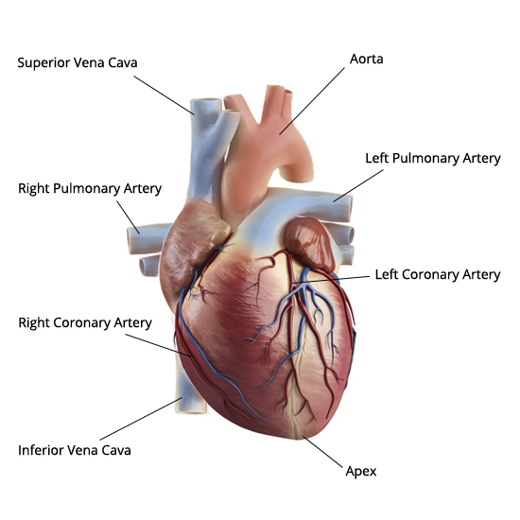
Coronary Artery Disease Basics Cont’d
https://leelammavarghese.files.wordpress.com/2014/06/human-heart-external-view.jpg

Slide 4
Proposed CAD Indicators
UCI Dataset Analysis:
Based on these 9 attributes that are indicators of heart disease, build a model: ⁽¹⁾
Age
Sex
Chest Pain (cp): typical angina or non-typical angina
Resting Blood Pressure (trestbps)
Serum Cholesterol (chol)
Fasting Blood Sugar (fbs): if > 120 mg/dl) (1 = true; 0 = false)
Resting Heart Rate (thalrest)
Exercise Induced Angina (exang): 1 = yes; 0 = no
Diagnosis of Heart Disease (num): based on angiographic disease status: < 50% diameter narrowing = 0; > 50% diameter narrowing = 1. Originally num was 0-4 with 0=no heart disease and 1-4=some form of heart disease. Changed all 1-4 values to 1=heart disease, left 0=no heart disease.
Based on relevant and current literature, verify these attributes are major indicators of heart disease. ^{(2, 3)}
Used Python to clean up data for 3 columns:
Trestbps: if == -9, set to None; use num for groupby; calculate mean trestbps; fill testbps =Nan
Chol: if == -9, set to None or if == 0, set to None; use num for groupby; calculate mean chol; fill chol =Nan
Thalrest: if == -9, set to None
Train the model to predict: who will/will not develop heart disease

Slide 5
Proposed CAD Indicators
NHANES Dataset Analysis and mapping to UCI Dataset:
Age = age
Sex = sex
Chest Pain (cp): typical angina or non-typical angina = cp
Resting Blood Pressure (trestbps) = trestbps
Serum Cholesterol (chol) = chol
LBXGLU = Fasting Blood Sugar (fbs): if > 120 mg/dl) (1 = true; 0 = false)
Resting Heart Rate (thalrest) = thalrest
CDQ002 = Exercise Induced Angina (exang): 1 = yes; 0 = no
Num = Diagnosis of Heart Disease (num): based on angiographic disease status: < 50% diameter narrowing = 0; > 50% diameter narrowing = 1. Originally num was 0-4 with 0=no heart disease and 1-4=some form of heart disease. Changed all 1-4 values to 1=heart disease, left 0=no heart disease.
Based on relevant and current literature, verify these attributes are major indicators of heart disease. ^{(2, 3)}
Used Python to clean up data for 4 columns:
‘Sex’: if != 1, set ‘Sex’=0;
‘cp’: if != 1, set ‘cp’=0,
‘CDQ002’: if != 1, set ‘CDQ002’=0 (=exang)
‘Num’ != 1, set ‘Num = 0
Use trained model to predict: who will/will not develop heart disease for NHANES dataset

Slide 6
UCI Dataset Information
Background Information Details
Datasets include 4 databases from 4 locations:
Cleveland: 282 records
Hungary: 294 records
Switzerland: 123 records
Long Beach: 200 records
Database Source Clinics and Creators:
Cleveland Clinic Foundation: Robert Detrano, M.D., Ph.D.
Hungarian Institute of Cardiology. Budapest: Andras Janosi, M.D.
Switzerland:
University Hospital, Zurich, Switzerland: William Steinbrunn, M.D.
University Hospital, Basel, Switzerland: Matthias Pfisterer, M.D.
V.A. Medical Center, Long Beach, CA: Robert Detrano, M.D., Ph.D.
Data Analyzed:
Original dataset: 920 records with 14 attributes
Cleaned dataset: 899 records with 9 attributes

Slide 7
NHANES Dataset Information
Background Information Details
2013-2014 Datasets include 1 databases (4 datasets)
5,000 individuals interviewed
Database Source Creators:
The National Center for Health Statistics (NCHS), Division of Health and Nutrition Examination Surveys (DHANES), part of the Center for Disease Control and Prevention (CDC)
Background:
Original dataset: 10,000 records with 48-224 attributes
Cleaned dataset: 646 records with 9 attributes

Slide 8
UCI Dataset Assumptions
Chose 9 attributes from the set that were most indicative of heart disease:
Age, sex, cp, trestbps, chol, fbs, thalrest, exang, and num
If 'trestbps' == -9, set 'trestbps' = None
If ‘chol' == -9, set chol' = None or if ‘chol’ == 0, set ‘chol’ == None
If ‘thalrest' == -9, set thalrest ' = None
find the mean of trestbps (resting bps) by age and use mean to fill in empty trestbps values with mean for age
find the mean of chol (cholesterol) by age and use mean to fill in empty chol values with mean for age
find the mean of thalrest (resting ???) by age and use mean to fill in empty thalrest values with mean for age
Write cleaned up data out to Excel file (clean2.xlsx)

Slide 9
NHANES Dataset Assumptions
The 2013-2014 Dataset was used. ⁽⁴⁾
5,000 individuals of all ages were interviewed.
Target Population included:
Hispanic persons;
Non-Hispanic black persons;
Non-Hispanic Asian persons;
Non-Hispanic white and other* persons at or below 130 percent of the poverty level; and
Non-Hispanic white and other* persons aged 80 years and older.
* Other: Non-Hispanic persons reported races other than black, Asian, or white
Check for columns with missing values
drop CDQ002 (chest pain when walking uphill and walking fast) with missing values

Slide 10
NHANES Dataset Assumptions Cont’d
find the mean of chol (cholesterol) by age and use mean to fill in empty chol values with mean for age
find the mean of thalrest (resting heart rate) by age and use mean to fill in empty thalrest values with mean for age
find the mean of LBXGLU( = UCI fbs) by age, and use mean to fill in empty LBXGLU values with mean for age
Round decimal columns to zero decimal points, set type = int
simplifying the “Sex“, "cp“, “CDQ002”(=UCI ‘exang’), and “Num” categories. Sex, cp, CDQ002, and Num values of != 1; set to zero
Write cleaned up data out to Excel file (NHanesTestData.xlsx)

Slide 11
CAD for UCI Datasets
 | Cleveland | Long Beach | Hungary | Switzerland
No | 157 | 51 | 187 | 8
Yes | 125 | 149 | 107 | 114
No = No CAD Present
Yes = CAD Present
Switzerland has largest # CAD present

Slide 12
UCI vs NHANES CAD
 | UCI | NHANES
No | 403 | 550
Yes | 495 | 96
No = No CAD Present
Yes = CAD Present
NHANES Dataset has MUCH LESS CAD

Slide 13
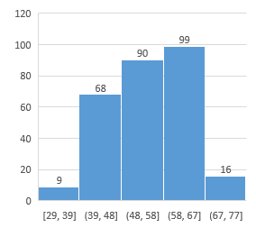
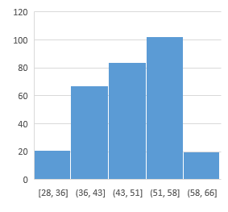
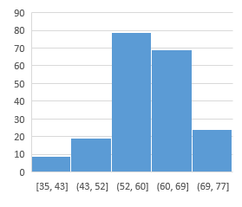
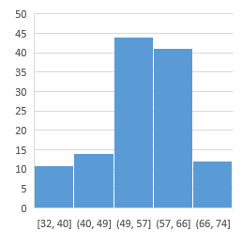
Age Distribution Per UCI Datasets
Cleveland | Long Beach | Hungary | Switzerland
All 4 databases in UCI dataset have fairly similar age distributions

Slide 14
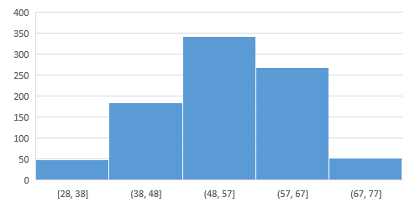
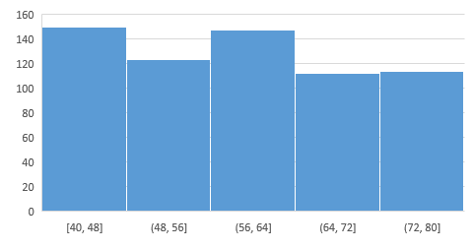
UCI vs NHANES Age Distribution
UCI | NHANES
NHANES dataset age distributed over 40 years (from 40 to 80 years old) while UCI dataset has bell curve with 49 years age distribution (from 28 to 77 years old).

Slide 15

Predictive Model: Random Forest Classifier
What is a Random Forest Classifier?
Collection of individual and independent decision trees (aka the “forest”)
For a given object, each tree in the forest independently classifies the object
Final classification of the object is the majority vote from the forest
https://www.maiafinancial.com.au/wp-content/uploads/2016/09/iStock-506856658-resize-2mb-1024x682.jpg

Slide 16
Predictive Model: Random Forest Classifier
Why Use a Random Forest Classifier?
Pros:
Binary-decision
Non-parametric: can use on data where true incidence or distribution of the variables is unknown.
Works for data with both categorical and numerical data (binary and continuous data).
Versus a Single Decision Tree
Reduces risk of model overfitting
More stable/robust—better able to handle dataset variation
Cons:
Depending on complexity of dataset, algorithm can be computationally expensive.

Slide 17
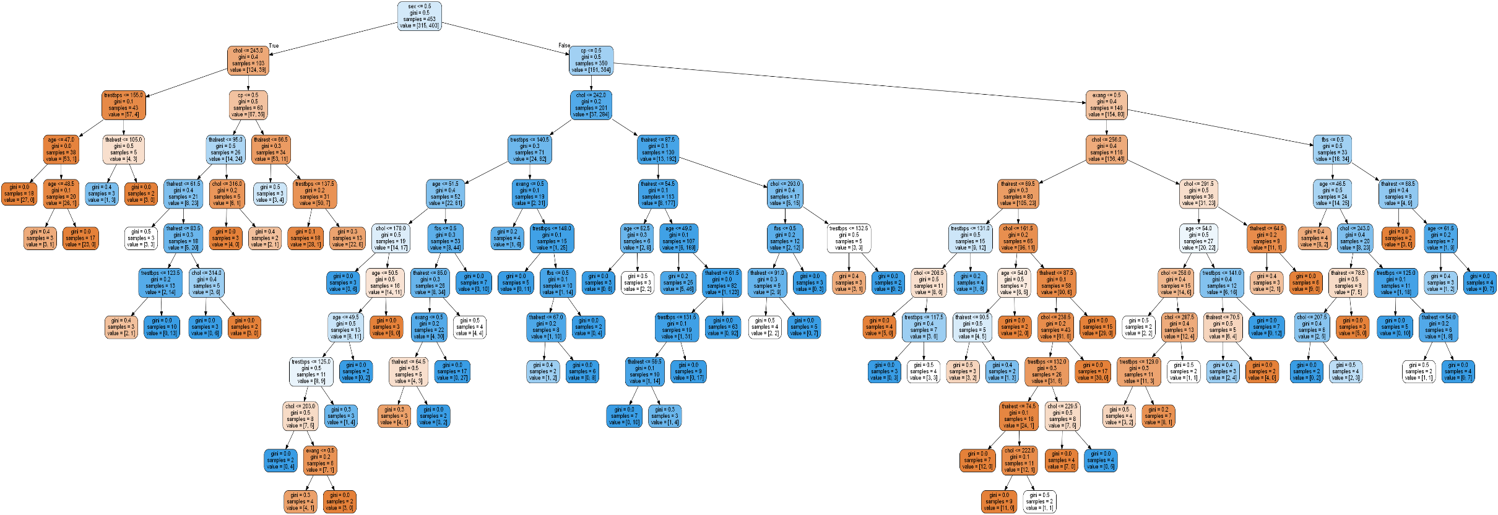
Example Tree from Random Forest
Tree #5

Slide 18
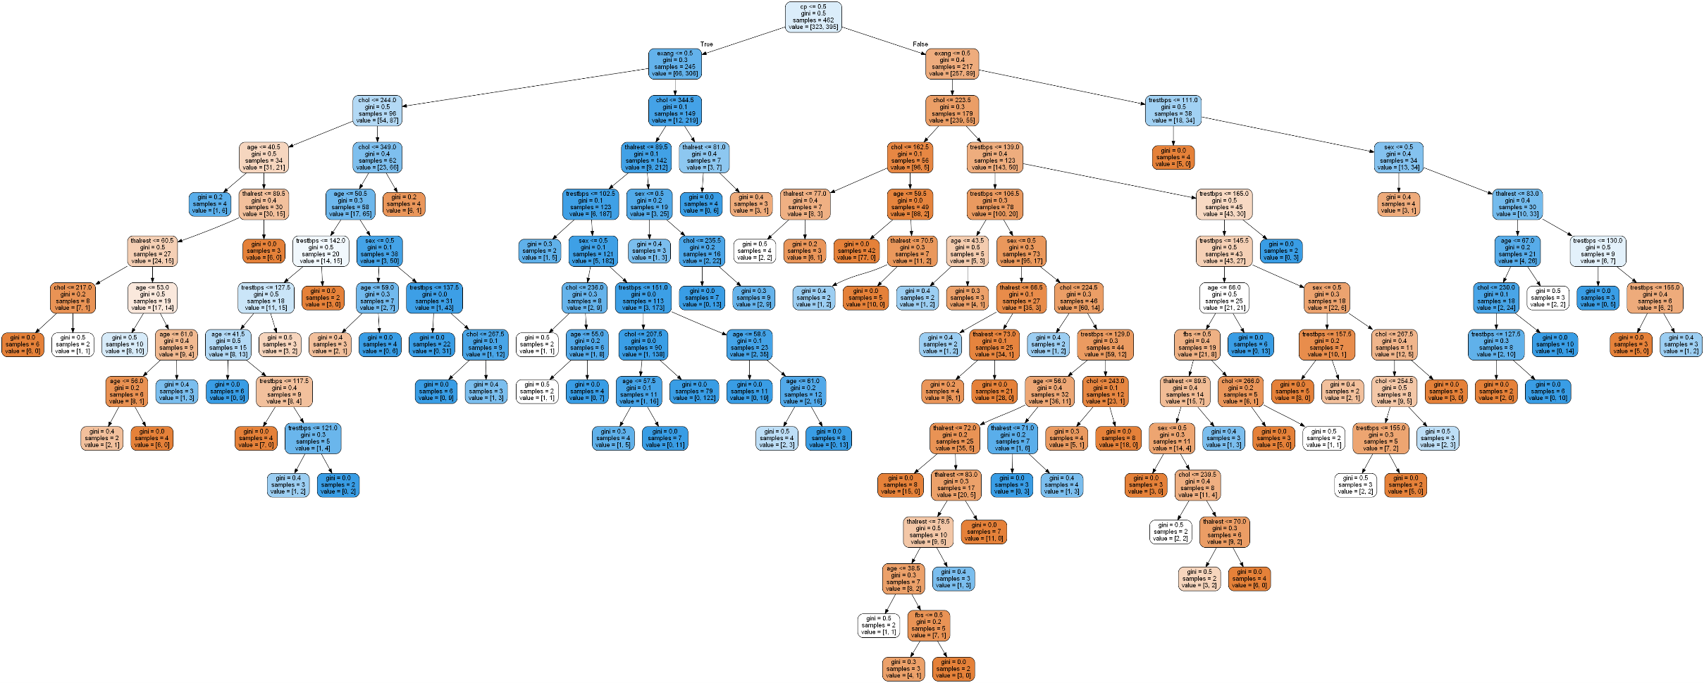
Example Tree from Random Forest
Tree #500

Slide 19
Results of Predictive Model Testing
Results Consistent with 80% Accuracy
UCI Dataset: Training and Testing
80% of the UCI Dataset was used for “training” the model.
20% of the UCI Dataset was used for testing the “trained model” with 80% accuracy.
NHANES Dataset Testing
This dataset was used for running a second test on the “trained model” to confirm the results from both testing scenarios returned similar results: 80% accuracy.

Slide 20
Model Statistics
UCI Training Dataset | NHANES Dataset

Slide 21
Conclusion
Predictive Model for CAD
Successful Implementation:
Our model worked with 80% accuracy in predicting the individuals that would develop coronary artery disease. This level of accuracy is high considering we were trying to predict the CAD health status of individuals using just 9 personal attributes that are known to be indicators of heart health risk factors. The original UCI dataset contained 74 attributes but we had to whittle that list down to just 9 in order to find good datasets to use for training and testing the model.
Successful but not without compromise:
The testing with the NHANES dataset appears to be skewed due to the differences in age distribution between the datasets. This occurred because we had to remove rows of data for patients under 40 because several measurements for these patients were not recorded.
Differences in terminology caused us to make some assumptions about the datasets. The fewer the assumptions we have to make, the better the test.

Slide 22
Suggested Further Study
Additional Study: Ideas for Improvement
We only used one set of the NHANES data collected between 2013-2014 to test our model. There are 3 more NHANES datasets that are more recent than the one we used for testing. There are also quite a few datasets collected in the years prior to 2013. The oldest dataset is for 1959-1962.
Besides testing additional datasets from NHANES, it would be an improvement if the model could be tested with other sources of CAD related datasets.
We should determine if there are different parameters (attributes) we would use for further tests assuming we could obtain the specified information. Considering the existing literature regarding risk factors for predicting CAD began with 74 different parameters and we only were able to use 9 of them in order to match other datasets to ours.
Additional Study: Use Datasets that match more closely
The NHANES dataset we used did not have several measurements for the patients under 40 years old which caused us to throw out more rows of data than we wanted to. It would be better if our datasets matched age distribution better.
Also, the differences in terminology made it more difficult to match fields from different datasets so the study would be better if those differences were removed.

Slide 23
References
Detrano, Robert, MD, PhD; Janosi, Andras, MD; Steinbrunn, Walter, MD; Pfisterer, Matthias, MD; Schmid, Johann-Jakob, DE; Sandhu, Sarbjit, MD; Guppy, Kern H, PhD; Lee, Stella, MS; Froelicher, Victor, MD. (1989, Aug). “International Application of a New Probability Algorithm for the Diagnosis of Coronary Artery Disease”. The American Journal of Cardiology, Volume 64, Issue 5, pp: 304-310.
Coronary Artery Disease. (n.d.) The Free Dictionary web site. Retrieved 7/11/2019 from https://medical-dictionary.thefreedictionary.com/coronary+artery+disease
University of California, Irvine (UCI) Heart Disease Dataset. (2016). Retrieved 7/8/2019 from https://data.world/uci/heart-disease
National Health and Nutrition Examination Survey (NHANES) Dataset. (2013-2014). Retrieved 7/8/2019 from https://www.kaggle.com/cdc/national-health-and-nutrition-examination-survey
Center for Disease Control and Prevention. National Center for Health Statistics NHANES Questionnaires, Datasets, and Related Documentation. (1959-2020). Retrieved 7/8/2019 from https://wwwn.cdc.gov/Nchs/Nhanes/Default.aspx
Coronary Artery Disease. (n.d.) Heart.org web site by The American Heart Association. Retrieved 7/8/2019 from https://www.heart.org/en/health-topics/consumer-healthcare/what-is-cardiovascular-disease/coronary-artery-disease

